Slide 1
... Download and install Anaconda...
Anaconda is a wide spread Python Distribution that is used by many data scientists and companies. It is a collection of packages supported by an organisation (Continuum).
https://www.anaconda.com/download/

Slide 2
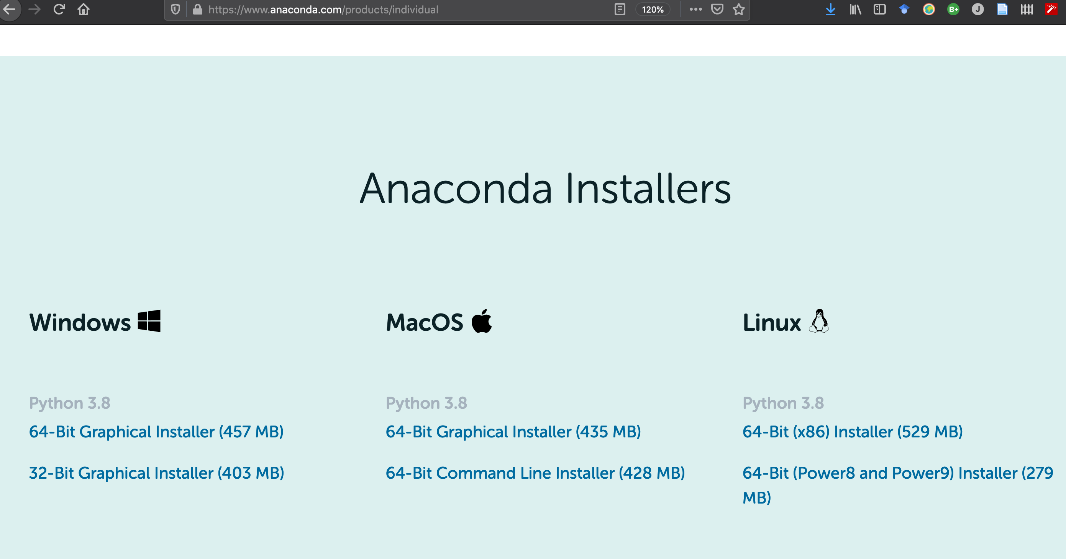

Slide 3
Installation
installer will guide you through the installation - hit continue when it's necessary.
Agree on their license.

Slide 4
These are the tools that Anaconda provides for you by default:
NumPy: A foundation for SciPy that allows you to work with data in arrays.
Matplotlib: Allows you to create 2D charts and plots from data.
Pandas: Tools and data structures to organize and analyze your data.
The scikit-learn library is how you can develop and practice machine learning in Python.The focus of the library is machine learning algorithms for classification, regression, clustering and more. It also provides tools for related tasks such as evaluating models, tuning parameters and preprocessing data.

Slide 5
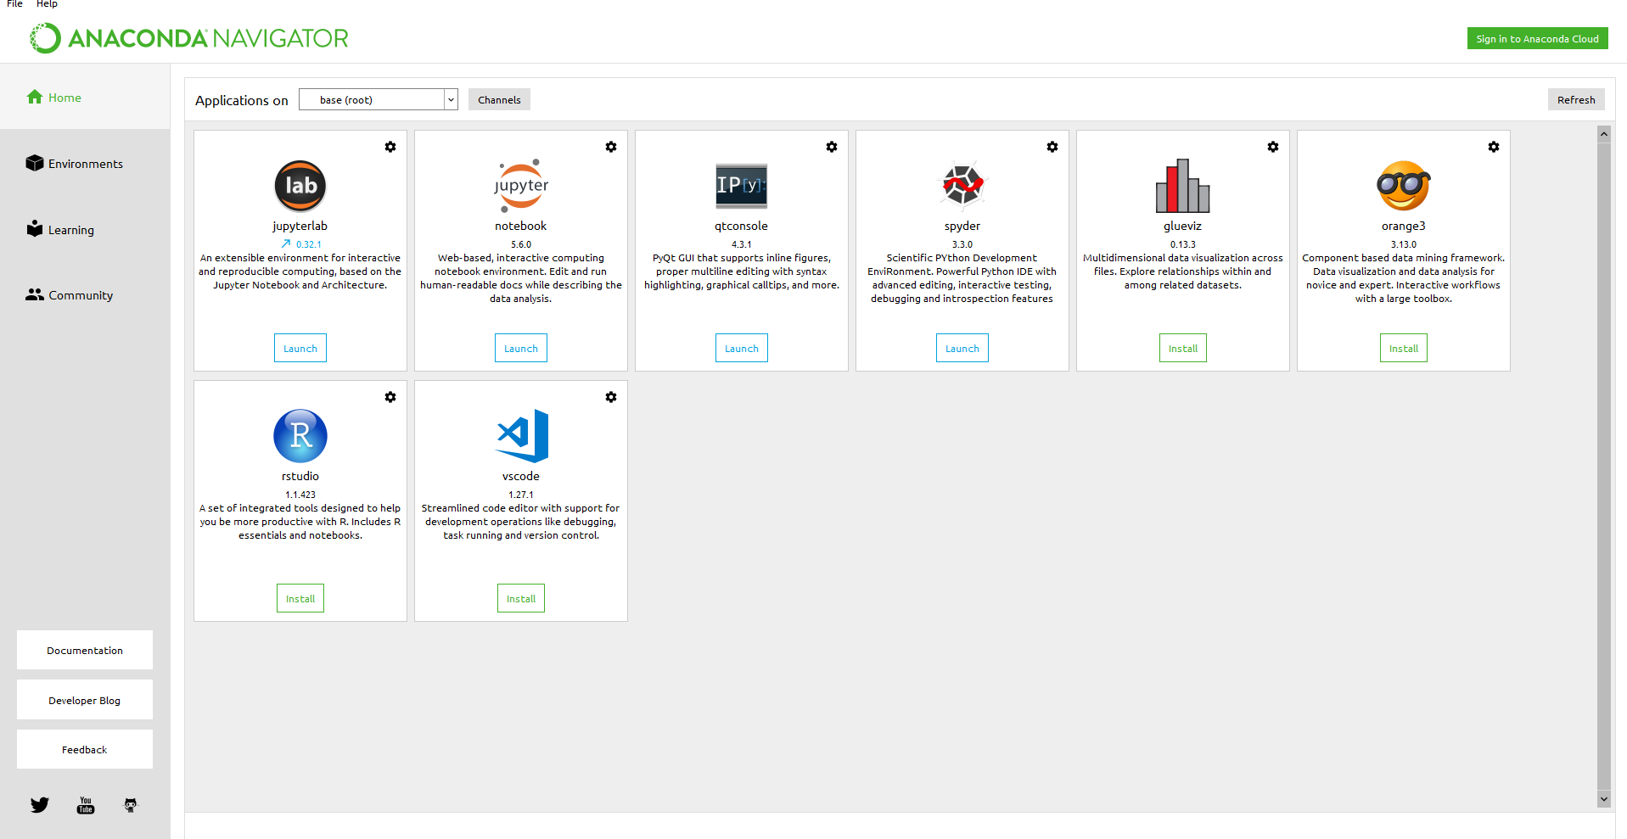
Open Anaconda Navigator
This is Jupyter Notebook that we will use during the course.

Slide 6
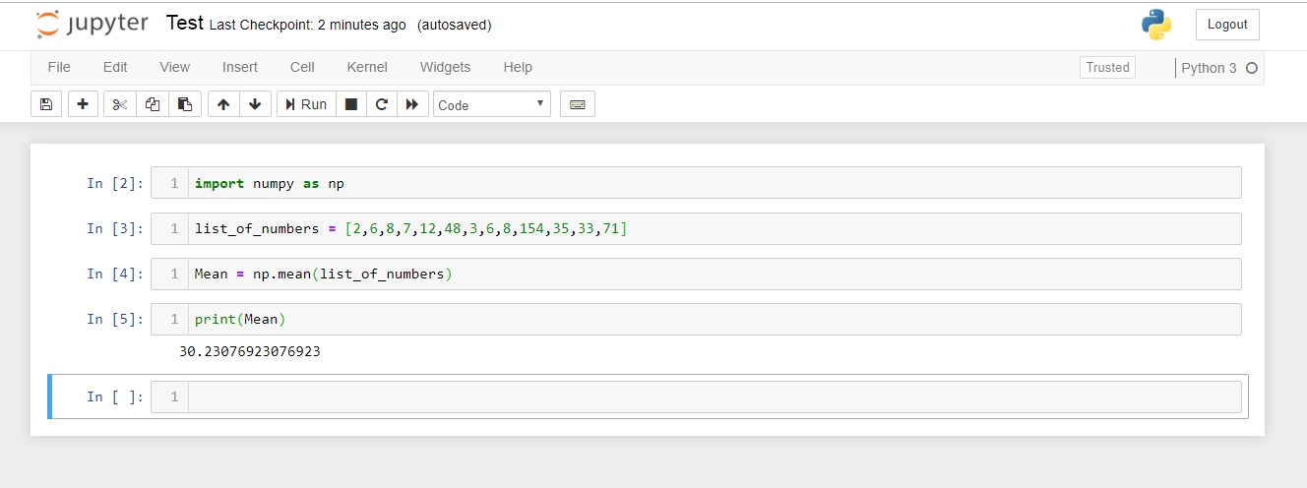
Name
Cells
Output
Shift + enter to run a cell
Alt + enter to run a cell and insert an empty cell below

Slide 7
Install Keras.
We will use keras only toward the end of the course. This library is not included in the initial installation so we need to install separately. You can do it now or later. I would recommend to do it at home using your Wifi connection since the University Wi-fi has some firewall restriction.

Slide 8
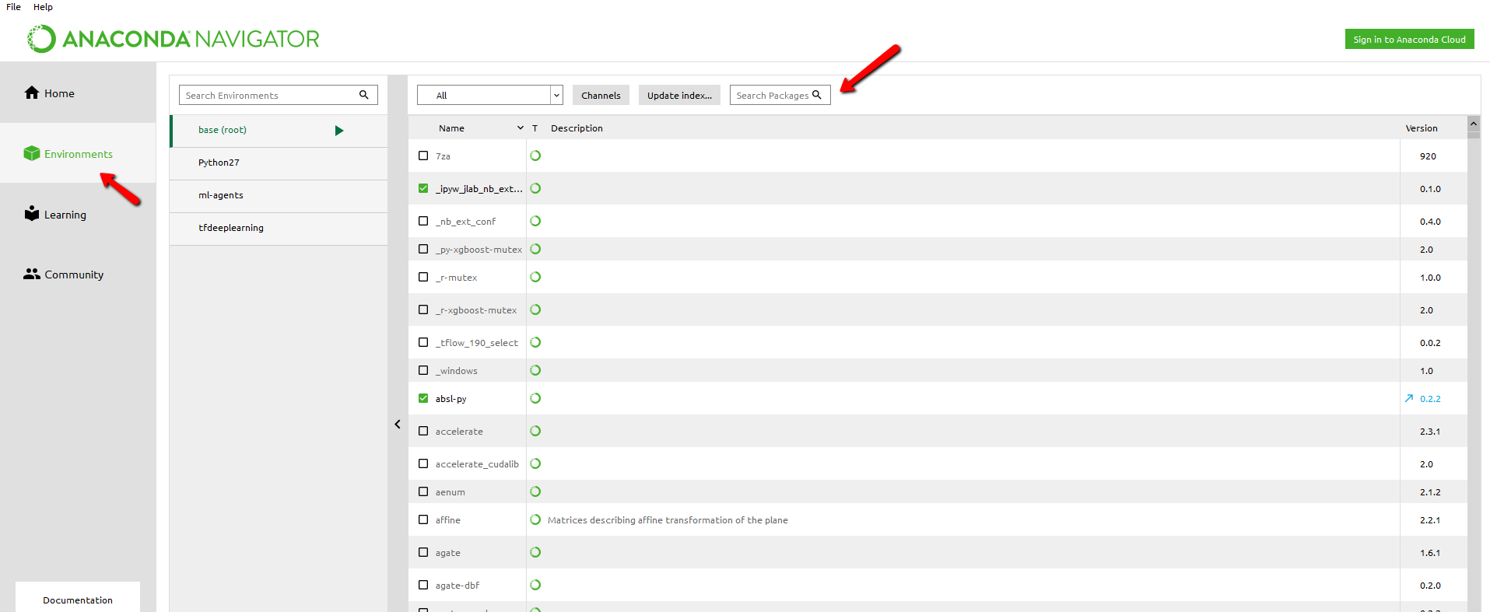
Install keras from Anaconda Navigator
2 - search for keras, select and then apply.
1 - Click on Environment tab

